Slide 1
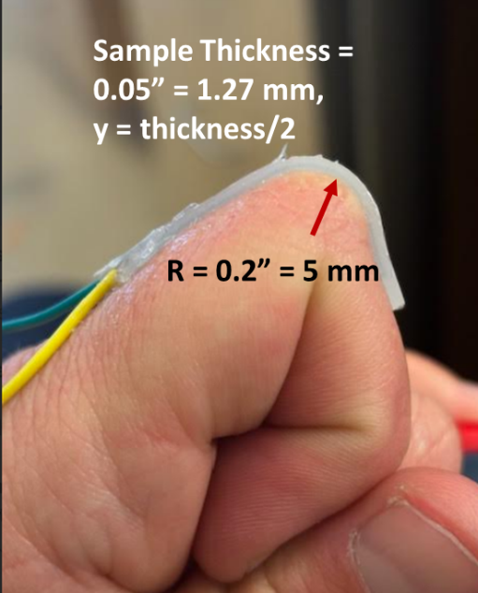

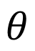
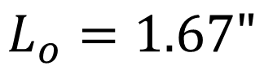
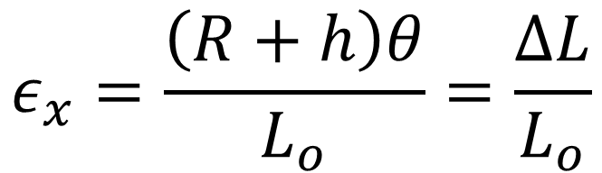
Human Knuckle Model
$$L_{o}=1.67"$$
h = 0.05” (1.27 mm)
R = 0.125”
$$θ$$
Measured Strain on finger with sample abs_100
(using strings)
~ 0.1677 or 16.8%
$$ε_{x}=\frac{\left(R+h\right)θ}{L_{o}}=\frac{ΔL}{L_{o}}$$

Slide 2

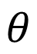
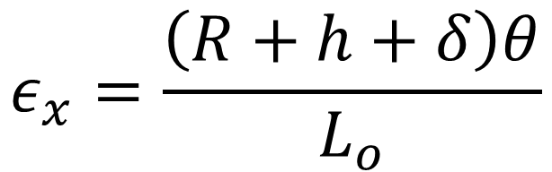
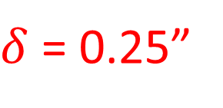
Auto Bender Model
h
R
$δ$ = 0.25”
$$θ$$
Measured Strain on sample abs_100 on AutoBender
~ 0.4 or 40%
$$ε_{x}=\frac{\left(R+h+δ\right)θ}{L_{o}}$$

Slide 3
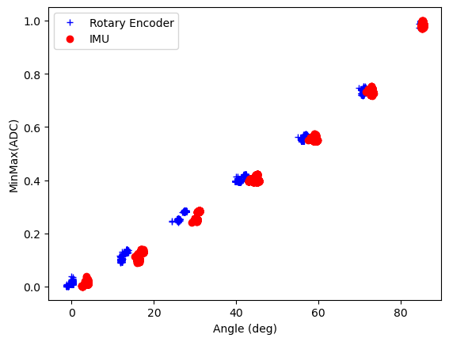
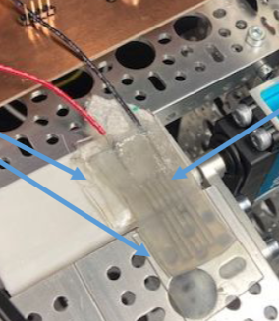
As a reminder….Sample ABS_100
40% elongation

Slide 4
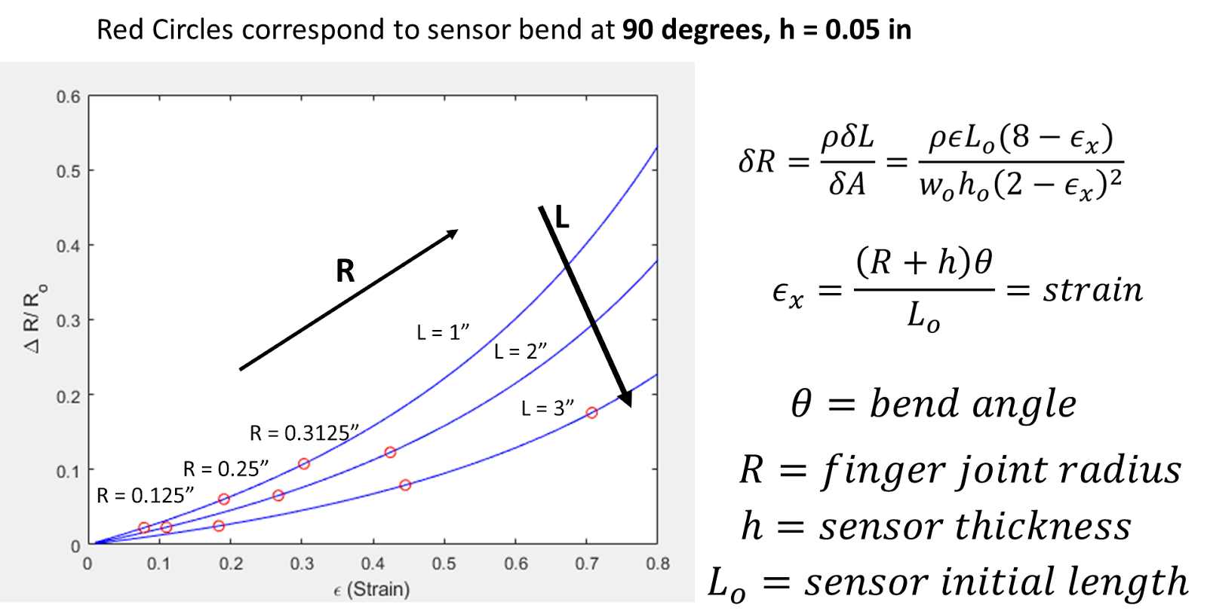
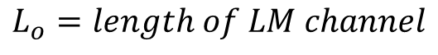
$$L_{o}=length of LM channel$$
Sample Length (not LM channel length)
Previous slide results strained to 40% elongation at L = 1.67”

Slide 5
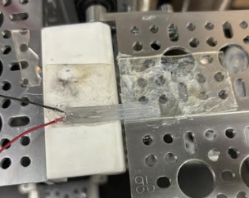
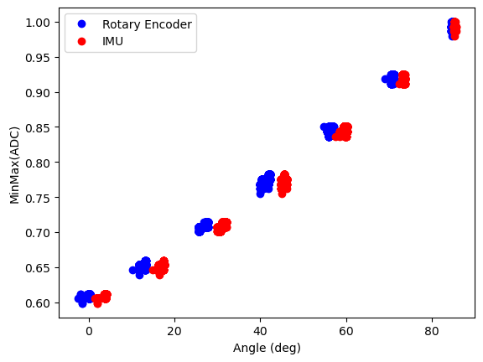
New Sample 11_21_2024
Wire Lead Gauge size CHANGED TO = 30 (from 28)
44.5% elongation
0.25” width
1.5” sample length
0.02” x 0.02” square cross-section channels

Slide 6
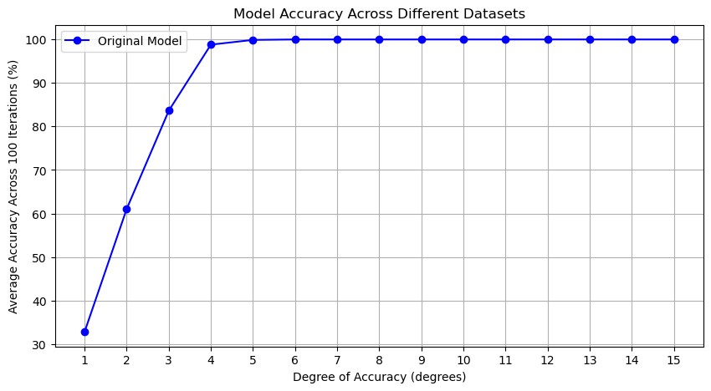

Slide 7
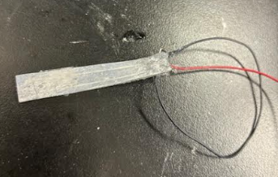
Sample 2.27” Long -> will test Monday

Slide 8
12_5_2024

Slide 9
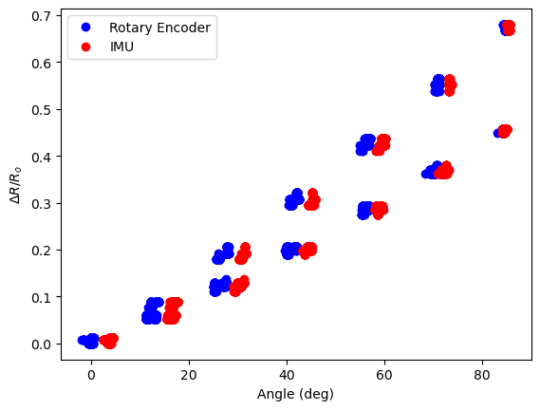
Comparing Sample Lengths
1.5 inches
2.31 inches

Slide 10
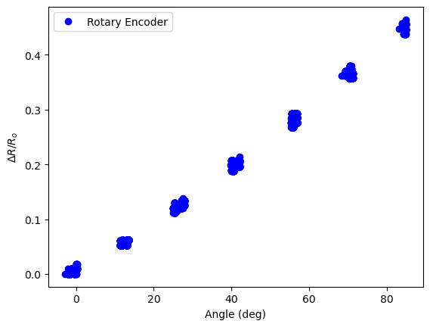
Across Two Samples: 2.3” and 2.31”

Slide 11
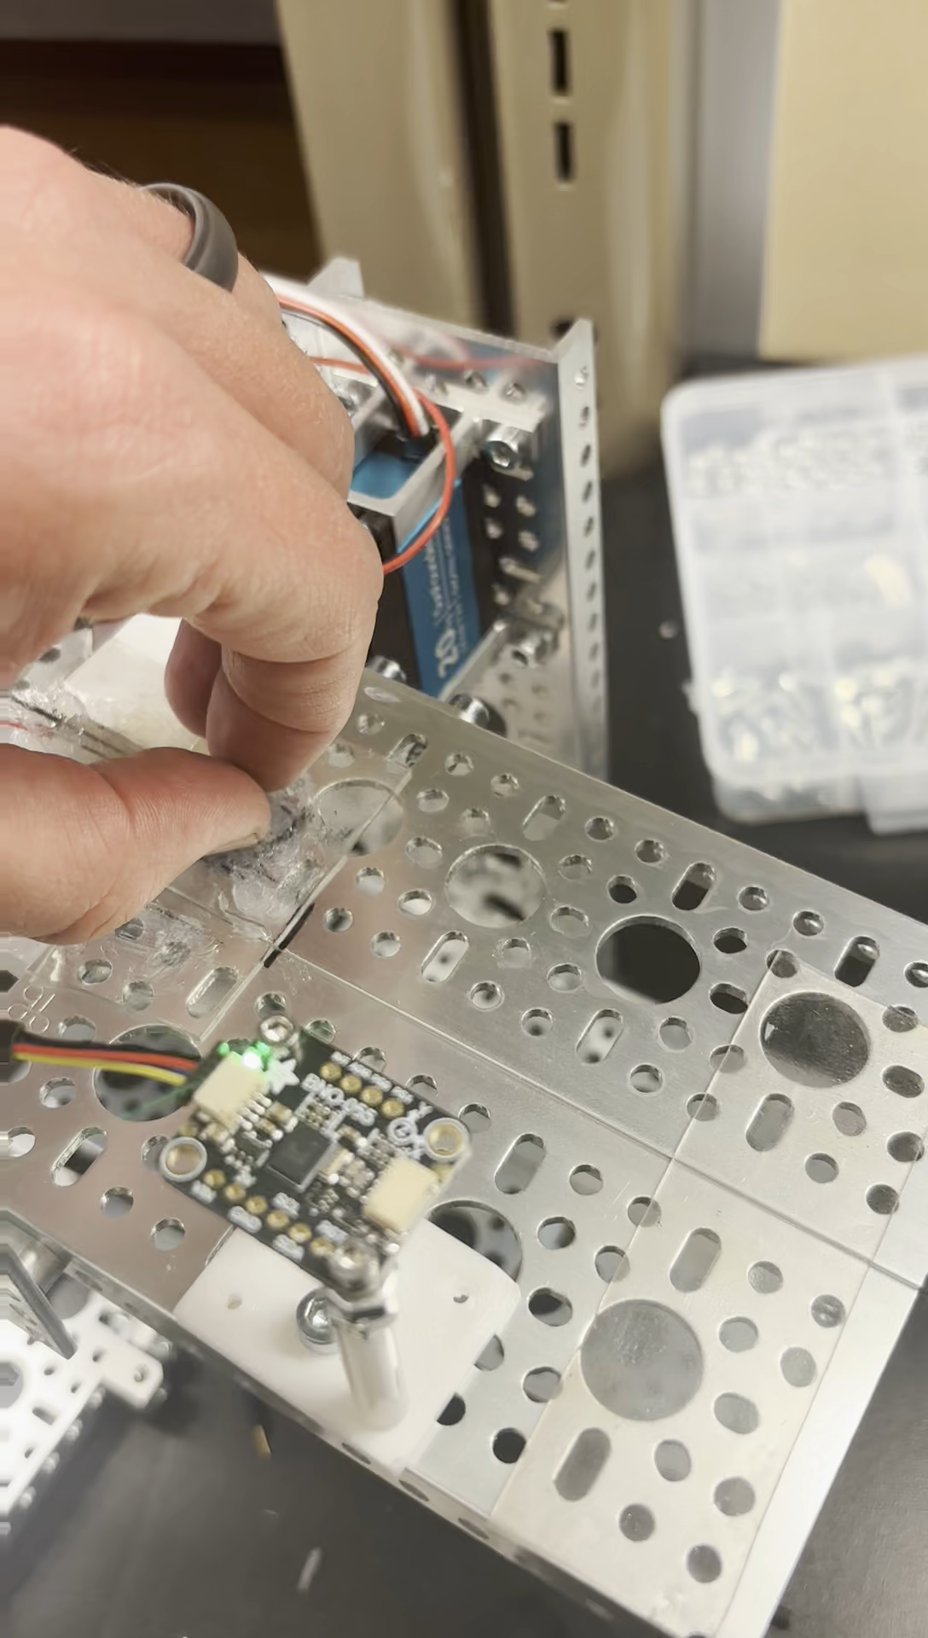
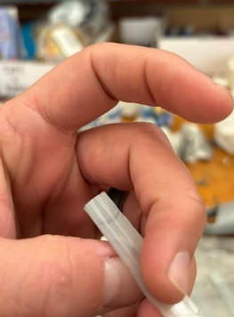
Initial Reapplication Issues
Problem Solved by Adding More Silicone to Inlet

Slide 12
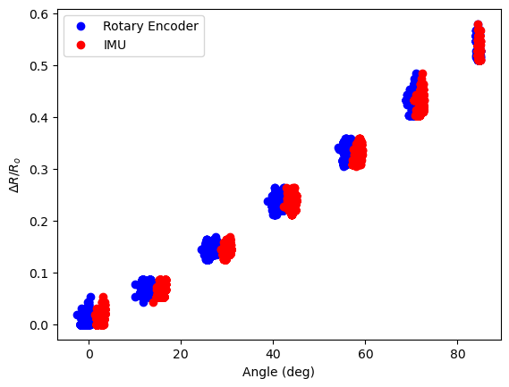
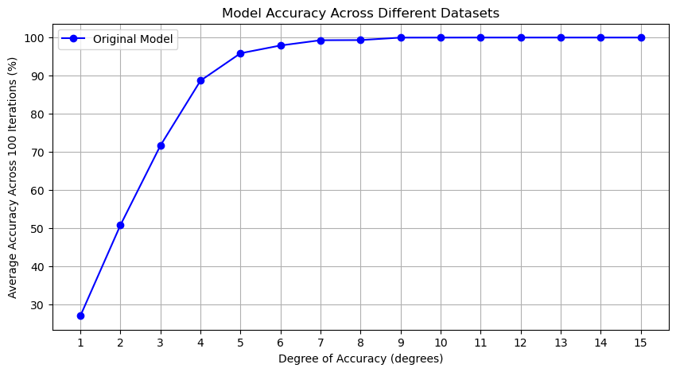
Reapplication 3x

Slide 13
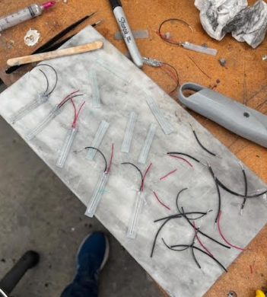
Angle Testing: Monday….

Slide 14
12/12/2024

Slide 15
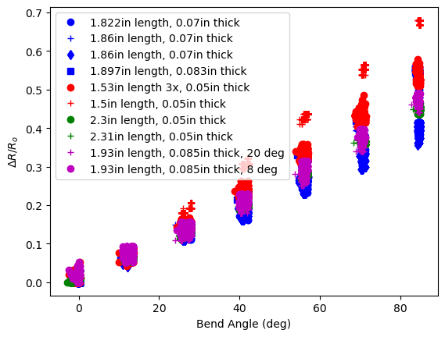

Slide 16
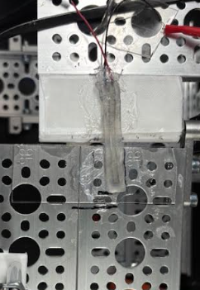
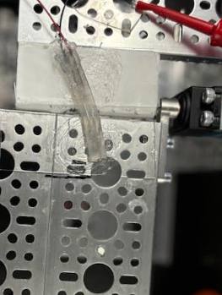
Angle Testing
8 Deg
20 Deg

Slide 17
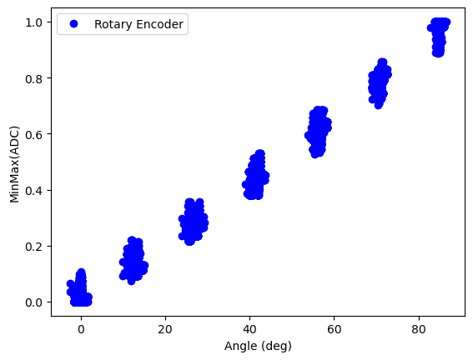
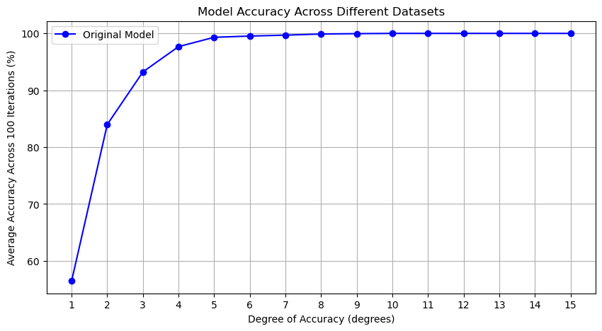

Slide 19
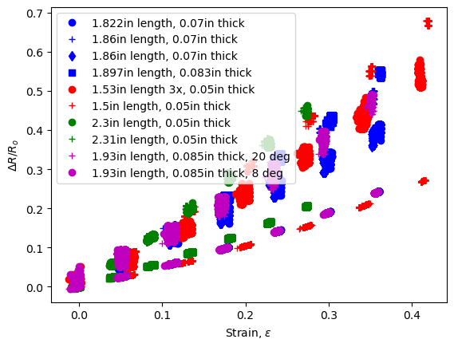
Model Data

Slide 20
12/19/2024

Slide 21
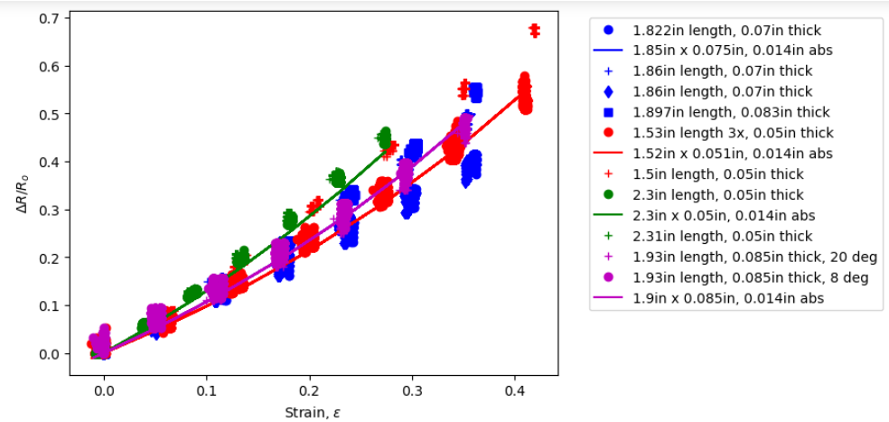
Model Curve Changes Drastically When ABS print size changes drastically by 0.001” (0.0254mm)
Changed cross section from 0.02” x 0.02” to 0.014” x 0.014”, so 0.006” height and width

Slide 22
Model Curve Changes Drastically When ABS print size changes drastically by 0.001” (0.0254mm)
Changed cross section from 0.02” x 0.02” to 0.014” x 0.014”, so 0.006” height and width
0.01” x 0.01”
0.02” x 0.02”

Slide 23
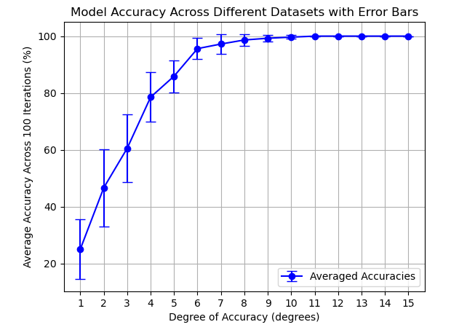
4x Reapplication Errorbars: Using MinMax -> 0 to 1 12 prediction files worth of data

Slide 24
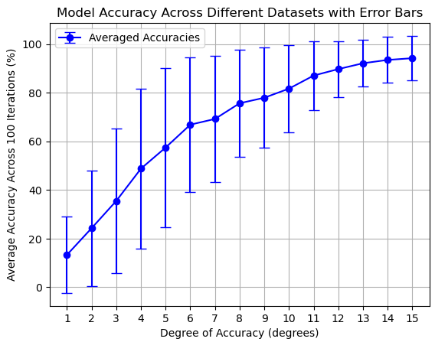
4x Reapplication Errorbars: Using Norm Res 12 prediction files worth of data

Slide 25
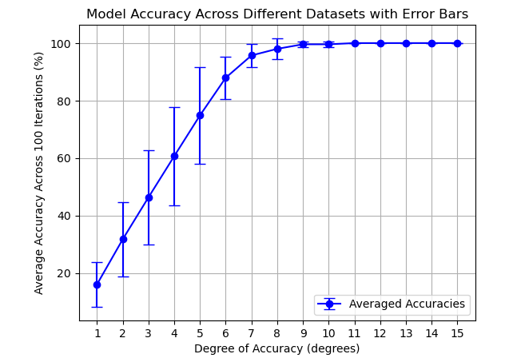
Misalignment and MinMax: 0, 8, 20 deg 6 prediction files worth of data

Slide 26
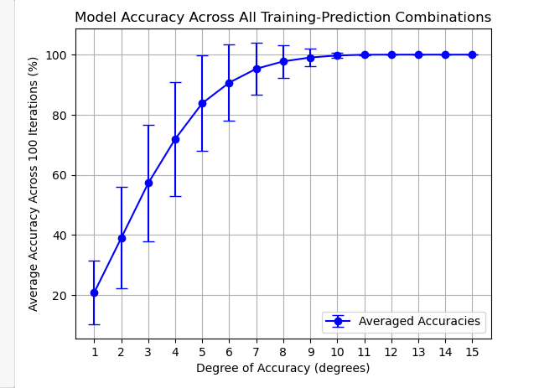
Across Sensor Repeatability: MinMax 12 files, where 1 is trained and is used to predict rest -> 132 prediction files in total

Slide 27
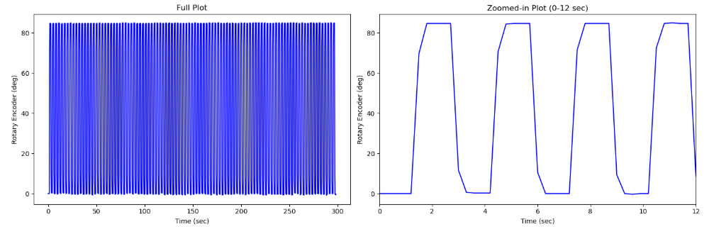
Rot Enc. Dynamic Test: 100 Cycles, Period is 300 ms, collect 5 data points every 300 ms, 333 deg/sec

Slide 28
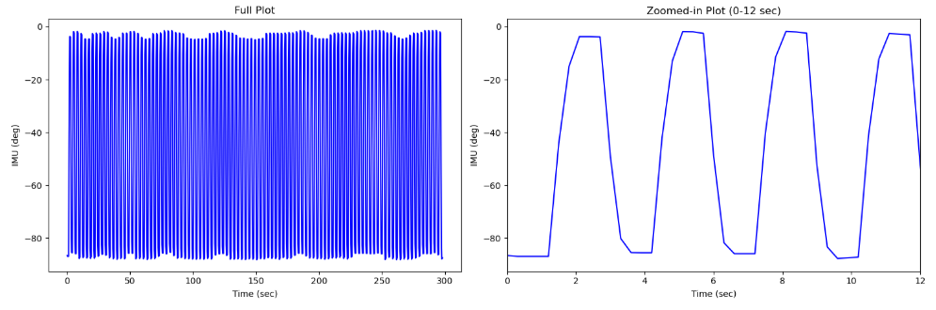
IMU Dynamic Test: 100 Cycles, Period is 300 ms, , collect 5 data points every 300 ms, 333 deg/sec

Slide 29
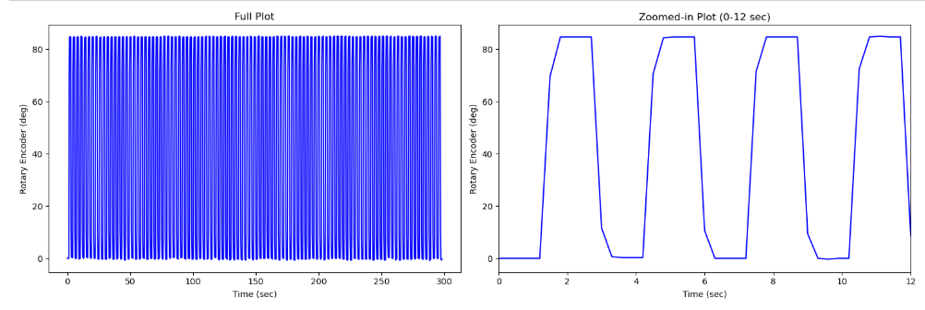
IMU Dynamic Test: 100 Cycles, Period is 1 sec, collect 15 data points every 1 sec, 333 deg/sec

Slide 30
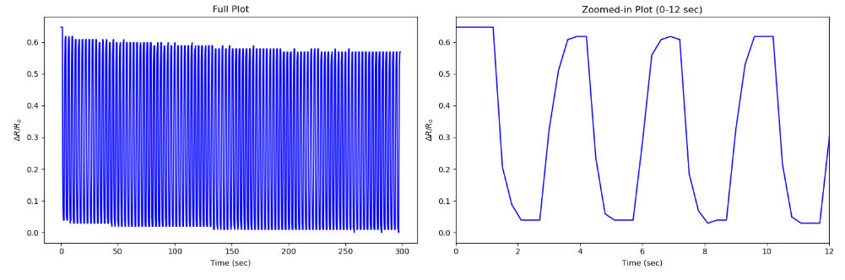
Strain Sensor Dynamic Test: 100 Cycles, Period is 300 ms, collect 5 data points every 300 ms, 333 deg/sec

Slide 31
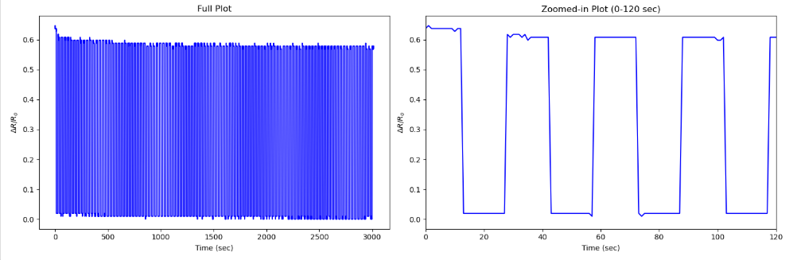
Strain Sensor Dynamic Test: 100 Cycles, Period is 1 sec, collect 15 data points every 1 sec, 333 deg/sec

Slide 32
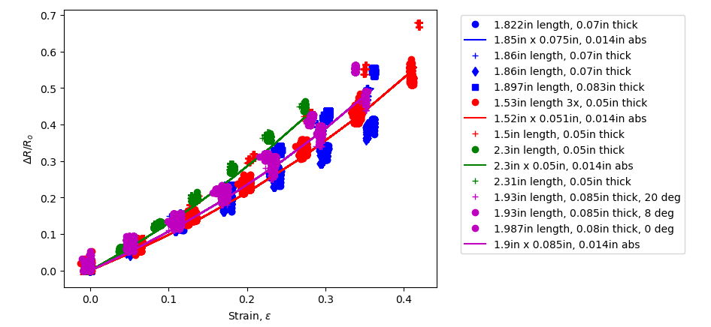
Comparing peak 0 deg norm res to 100 cycle

